Slide 1

Data Science Basics
RBS Greenhouse
RTU Riga Business School Greenhouse program
Greenhouse.rbs.lv

Slide 2
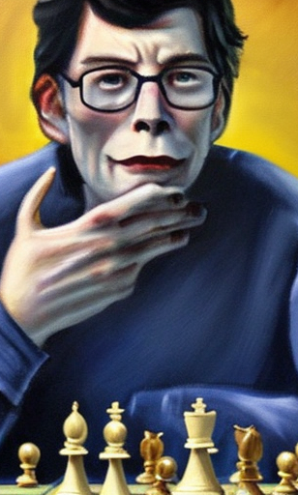
About Me
Valdis Saulespurēns
30+ Years programming
Lector RTU RBS
Researcher National Library of Latvia
valdis.saulespurens@rtu.lv

Slide 3
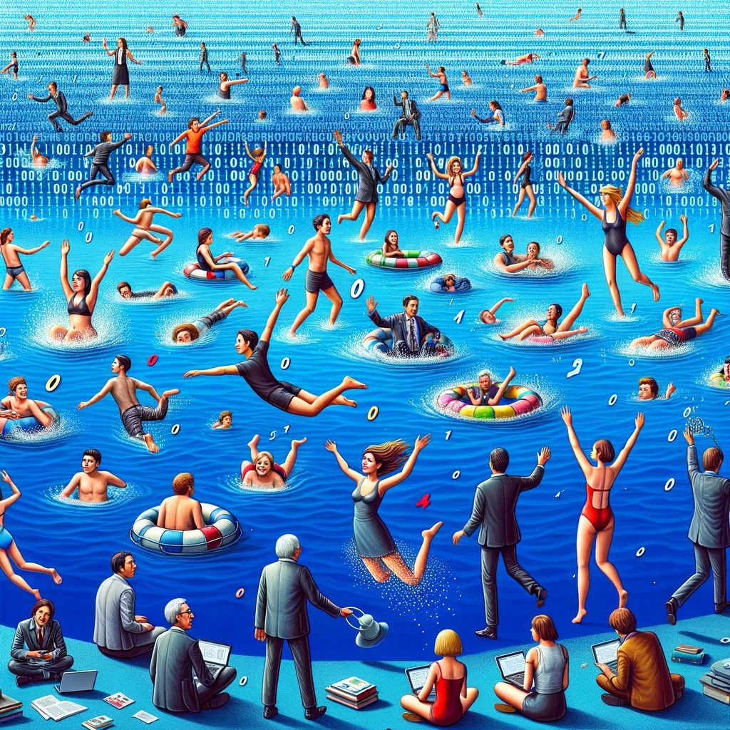
Data Lake – is everything alright?

Slide 4

Data Science intro
Data science is like being a detective, but instead of solving crimes, you're uncovering hidden truths and secret patterns in mountains of data!
You'll use all kinds of cool tools and techniques from statistics, computer science, artificial intelligence and your own expertise to explore data from all sorts of sources. And the best part is you get to use all of that information to make predictions and decisions that can change the world!

Slide 5
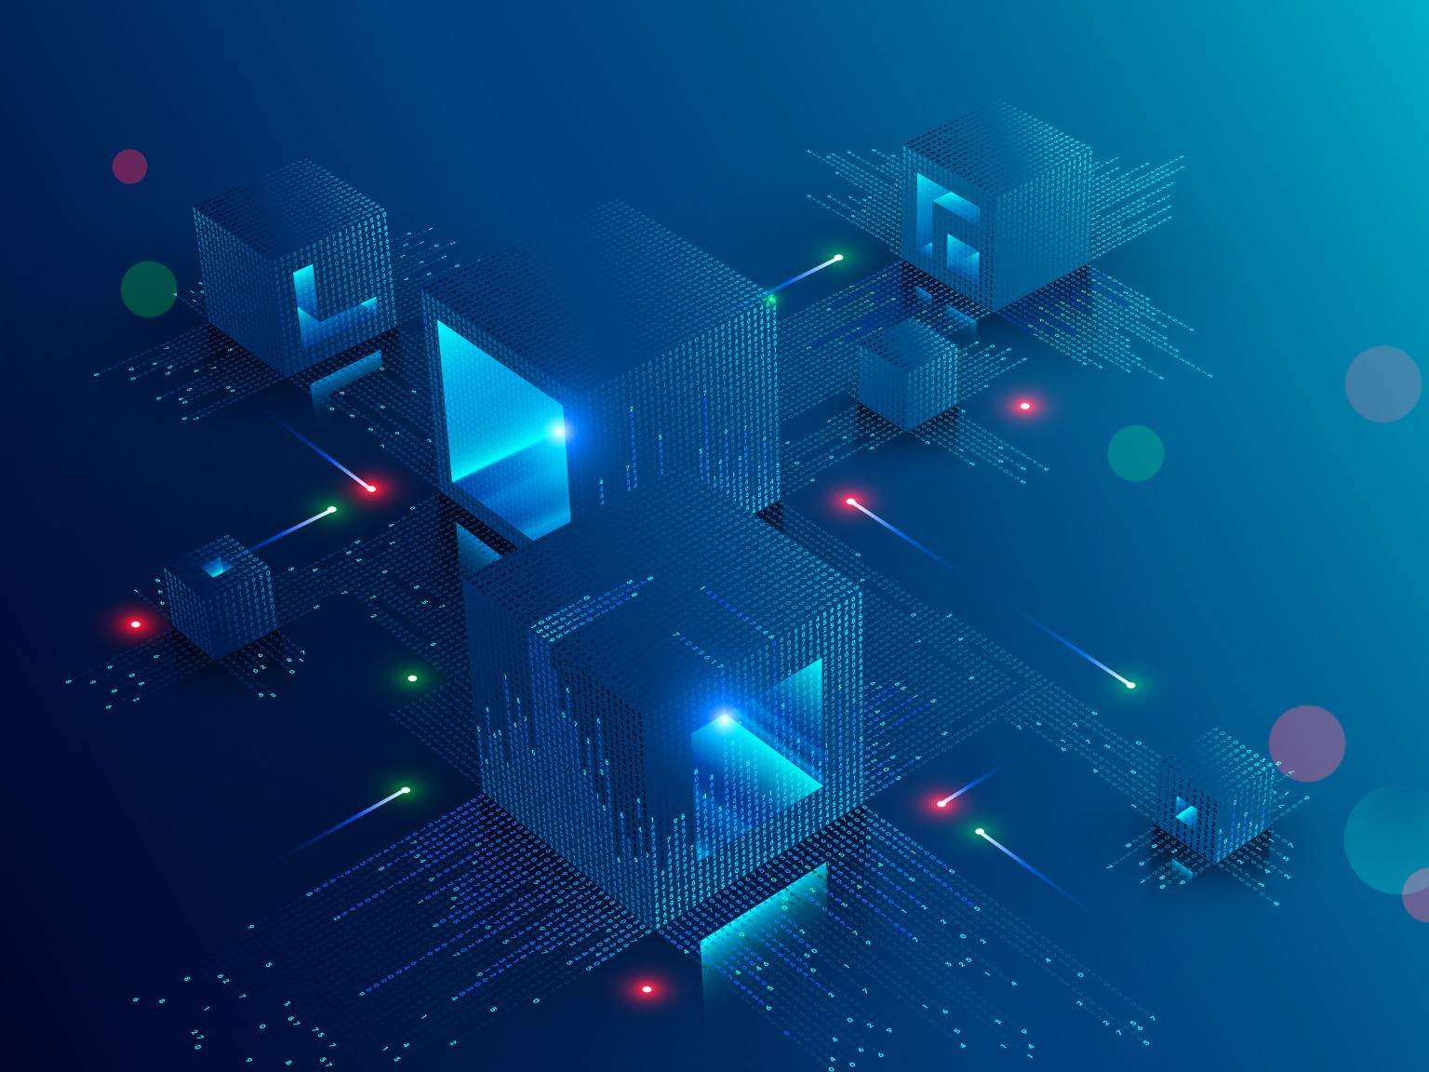
Data Science definition
Data science - interdisciplinary field that involves using scientific methods, processes, systems, and infrastructures to extract knowledge and insights from structured and unstructured data.

Slide 6
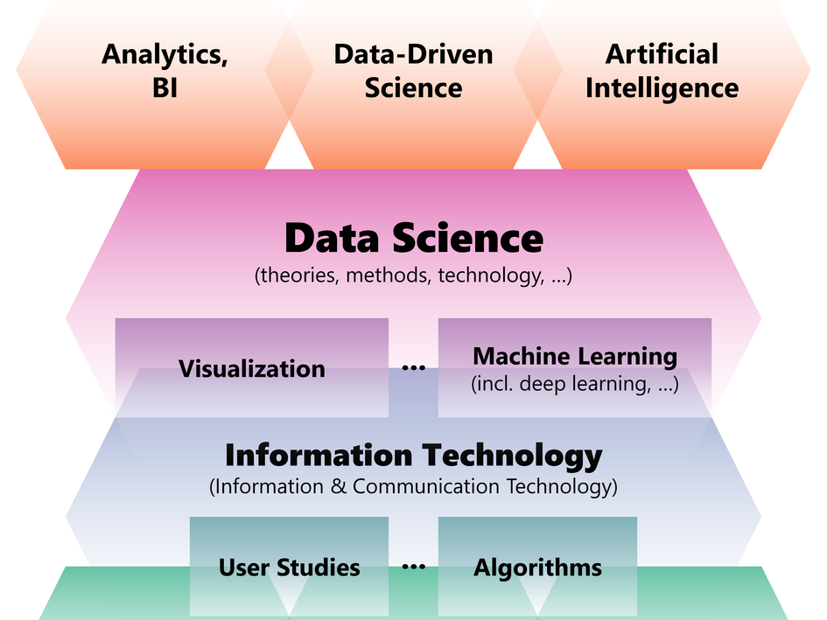
Src: University of Bergen

Slide 7

Applications of Data Science
Forecasting the likelihood of severe storms using data from weather sensors.

Slide 8

Applications of Data Science
Using data from GPS and social media to recommend the best places to eat or hang out with friends in a city.

Slide 9

Applications of Data Science
Using data from fitness trackers and wearables to monitor personal health and make personalized workout and nutrition recommendations.

Slide 10

Applications of Data Science
Predicting product preferences using data from social media

Slide 11

Applications of Data Science
Using data from online learning platforms to identify which students are struggling and providing targeted support to help them succeed.

Slide 12

Applications of Data Science
Using data from traffic cameras and sensors to optimize traffic flow and reduce congestion on roads and highways.

Slide 13

Applications of Data Science
Using data from social media to understand public opinion and sentiment on different issues and topics.

Slide 14
Data Science in high school
The above list is just small sampling, there are many more!
What could be some potential use of data science in high school?

Slide 15

Sub-disciplines of Data Science
Machine learning:
a subfield of data science that focuses on developing algorithms and models that enable computers to learn from data and make predictions or decisions without being explicitly programmed to do so.
ML has multiple subfields such as:
Supervised learning, unsupervised learning and..

Slide 16

Sub-disciplines of Data Science
Deep learning:
a subset of machine learning that involves the use of neural networks to model complex patterns in data
type of mathematical model inspired by the way the human brain works.
Neural networks are composed of layers of interconnected nodes, or artificial neurons, that process and transmit information. Each layer of neurons can learn to extract a different level of abstraction from the input data. The more layers a neural network has, the "deeper" it is, thus the term "deep learning".

Slide 17

Sub-disciplines of Data Science
Natural language processing (NLP):
a subfield of data science that deals with the interaction between computers and human languages, and includes tasks such as language translation, text summarization, and sentiment analysis.

Slide 18

Sub-disciplines of Data Science
Computer vision:
a subfield of data science that deals with the use of computer algorithms to understand and interpret visual data, such as images and videos.

Slide 19
Sub-disciplines of Data Science
Predictive modeling:
a subfield of data science that uses statistical and machine learning techniques to build models that can predict future events or outcomes based on historical data.

Slide 20
Sub-disciplines of Data Science
Recommender Systems:
a subfield of data science that builds systems that can predict what a user may be interested in based on their past interactions and behaviors.

Slide 21

Sub-disciplines of Data Science
Anomaly detection:
a subfield of data science that deals with identifying unusual or abnormal patterns in data, which can be useful for detecting fraud, errors, or other outliers.

Slide 22
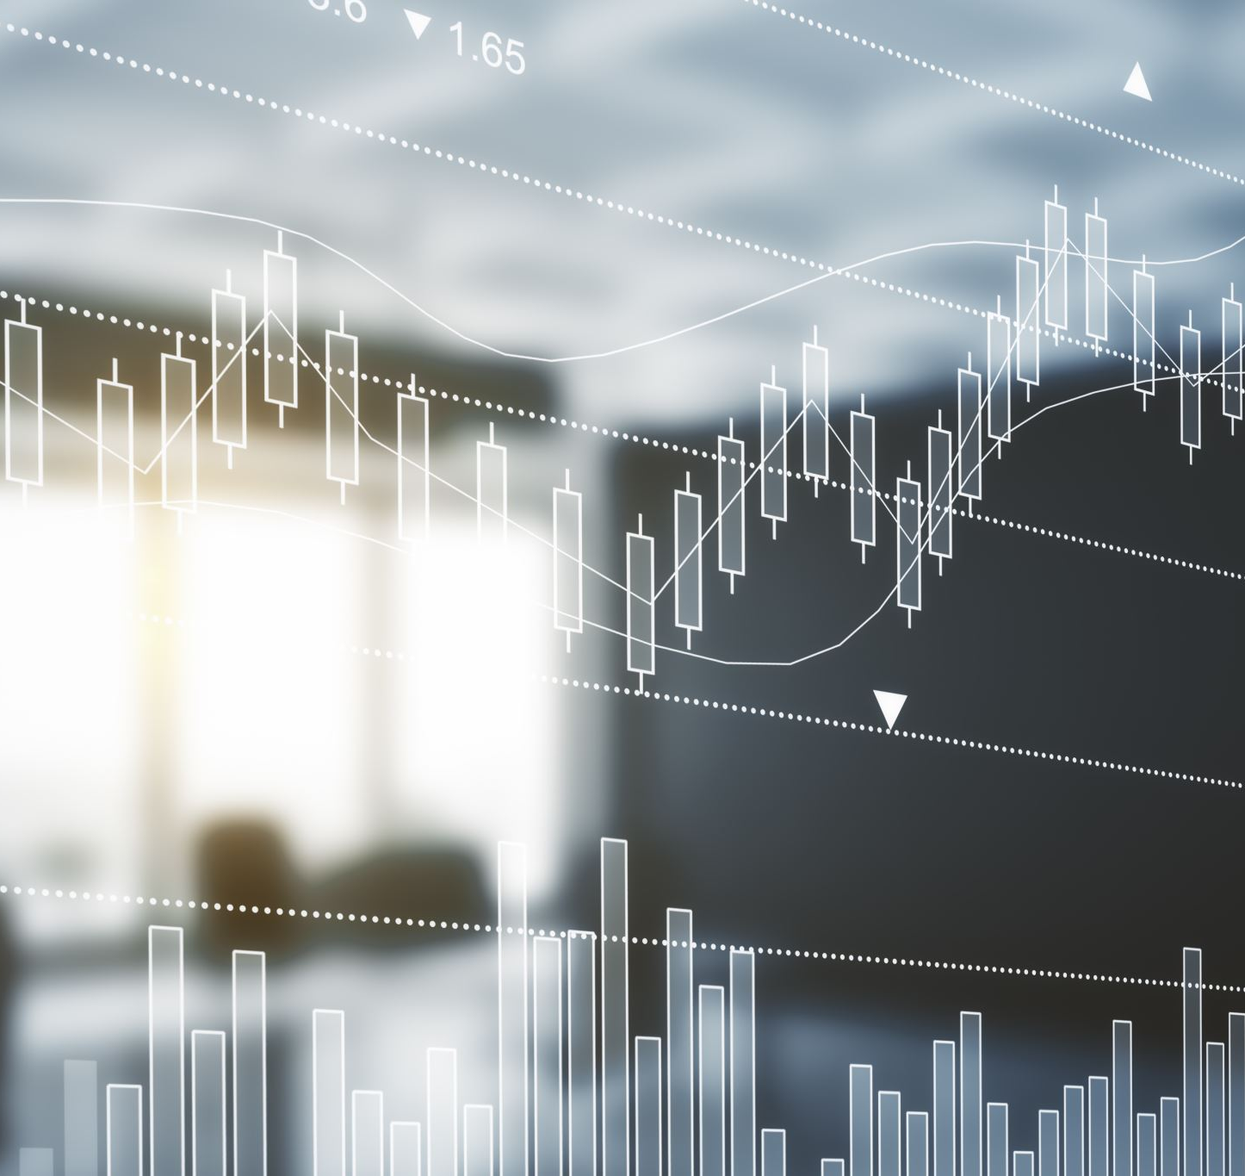
Sub-disciplines of Data Science
Data visualization:
a subfield of data science that deals with the design and creation of visual representations of data, such as charts, graphs, and maps, to communicate information and insights effectively.

Slide 23

The process - the "pipeline"
Collecting data
Cleaning and preparing the data
Analyzing the data - Exploratory Data Analysis - Visualization
Using the insights gained to make decisions or predictions - building a model
Deployment - "shipping" - making an app/program/
Monitoring for results / changes / improvements -> Back to Squares (1,2,3,4,5)

Slide 24
Difference between Data Scientist and Data Engineer
Data scientists and data engineers are both important roles in the field of data science, but they have different responsibilities and focus on different aspects of the data pipeline.

Slide 25
Data Scientist
Data scientists are responsible for analyzing and interpreting data, and using that information to make predictions or decisions. They use statistical and machine learning techniques to build predictive models, and they often work closely with stakeholders to understand their needs and communicate the results of their analysis.

Slide 26
Data Engineer
Data engineers, on the other hand, are responsible for the technical infrastructure and tools that support data science work. They design, build and maintain the systems that collect, store, and process data, and they ensure that data is accurate, reliable, and easily accessible to data scientists and other stakeholders. They work with technologies like Hadoop, Spark, and SQL databases to extract, transform and load the data.
Both roles often overlap.

Slide 27
POP QUIZ
What is the main goal of data science?
a) To extract insights and knowledge from data b) To collect and organize data
c) To make predictions and decisions
d) To build predictive models

Slide 28

POP QUIZ
What are the common techniques used by data scientists?
a) statistics and machine learning
b) natural language processing and computer vision
c) data visualization and deep learning
d) All of the above

Slide 29

POP QUIZ
What is the difference between data scientist and data engineer?
a) Data scientists focus on data analysis and modeling, while data engineers focus on data infrastructure and tools
b) Data scientists focus on data storage, while data engineers focus on data analysis
c) Data scientists focus on data visualization, while data engineers focus on data modeling
d) Data scientists focus on machine learning, while data engineers focus on statistics

Slide 30

POP QUIZ
What is one example of a task that falls under the area of Natural Language Processing (NLP)?
a) Image recognition
b) Language translation
c) Anomaly detection
d) Recommender systems

Slide 31

POP QUIZ
What is one example of a task that falls under the area of Computer Vision?
a) Sentiment analysis
b) Object recognition
c) Time series forecasting
d) Recommender systems

Slide 32

ANSWERS
Answers: 1-c 2-d 3-a 4-b 5-b
PS I would debate about 1-c

Slide 33
Tools of the trade
Programming Languages
There are several programming languages that are commonly used in data science.
It's worth noting that a data scientist may not necessarily need to know all of these languages but having a strong knowledge of one or two of these is sufficient, as they are often used in combination with other technologies and tools to perform data science tasks.

Slide 34

Python
Python is a widely-used, high-level programming language that is popular among data scientists because of its simplicity, readability, and wide range of powerful libraries and frameworks for data analysis, modeling, and visualization.
Some of the most commonly used libraries for data science in Python include NumPy, pandas, scikit-learn, and TensorFlow.
This Photo by Unknown Author is licensed under CC BY-SA

Slide 35

R:
R is a programming language and environment for statistical computing and graphics. It is widely used among statisticians, data scientists and academics, and it has a large community that develops and maintains a wide range of packages for data analysis, visualization and modeling.
This Photo by Unknown Author is licensed under CC BY-SA

Slide 36
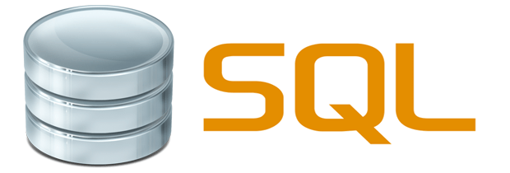
SQL:
SQL (Structured Query Language) is a domain-specific language used for managing relational databases. It is widely used to access, retrieve and manipulate data stored in databases, which is often a key component of data science projects.
This Photo by Unknown Author is licensed under CC BY

Slide 37
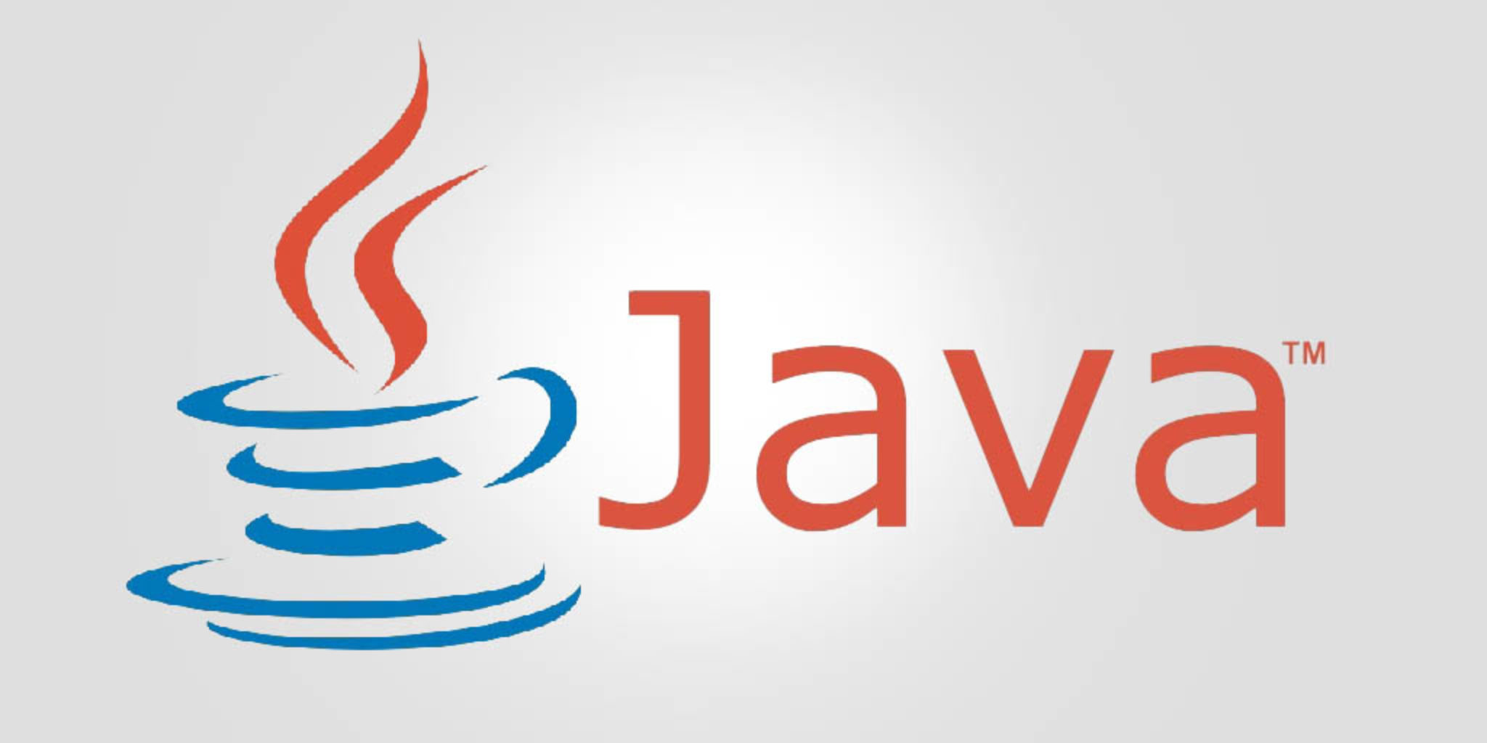
Java and Scala:
This Photo by Unknown Author is licensed under CC BY-SA
Java and Scala are general-purpose programming languages that are widely used in industry. They are popular for big data processing using technologies like Apache Hadoop and Apache Spark.

Slide 38

Julia:
Julia is a high-performance, high-level programming language for technical computing, with syntax that is familiar to users of other technical computing environments. It is designed to be fast and easy to use, and it is gaining popularity among data scientists and researchers.
This Photo by Unknown Author is licensed under CC BY-SA

Slide 39
Text Editors
Visual Studio Code: Visual Studio Code is a popular text editor that is available for Windows, Mac, and Linux. It is developed by Microsoft and it offers advanced features such as debugging, code completion, and built-in Git support.
PyCharm: PyCharm is a powerful, cross-platform text editor that is specifically designed for Python development. It offers advanced features such as code completion, debugging, and integration with version control systems.
RStudio: RStudio is a powerful, cross-platform text editor that is specifically designed for R development. It offers advanced features such as code completion, debugging, and integration with version control systems.
Many others, try out different ones

Slide 40
Other Software
Jupyter Notebook is an open-source web application that allows data scientists to create and share documents that contain live code, equations, visualizations, and narrative text. It is often used in data science to:
Clean and explore data: Jupyter Notebooks allow data scientists to load, manipulate and visualize data in an interactive way, making it easy to understand the data and identify any issues or outliers.
Develop and test models: Jupyter Notebooks allow data scientists to develop, test and iterate on models in an interactive environment. They can quickly test different algorithms and parameters, and visualize the results.
Communicate and share results: Jupyter Notebooks are a great tool for data scientists to communicate their findings and results to others. They can include text, images, and code in one document, which makes it easy to understand the results and the steps that were taken to produce them.
Collaboration: Jupyter Notebooks are also useful for collaboration and reproducibility, as they allow multiple data scientists to work on the same notebook and keep track of the changes made.
Jupyter Notebooks can be used with different languages like Python, R, Julia, Scala, and many more.

Slide 41

Git and Github
Git is a popular version control system that is widely used in data science for several reasons:
Collaboration: Git allows multiple data scientists to work on the same project and keep track of the changes made by each member.
Reproducibility: By using Git, data scientists can keep track of the changes made to the code, data, and documentation. This allows them to reproduce the results of an analysis or experiment at a later date, and also allows others to reproduce the results.
Backup and archiving: Git allows to store the code, data and documentation in a remote repository, like GitHub, GitLab or Bitbucket.
Experimentation: Git allows data scientists to easily test out different ideas and approaches without affecting the main codebase.
Versioning: Git also allows data scientists to save different versions of their code, data and documentation, which is useful when experimenting with different approaches.
This Photo by Unknown Author is licensed under CC BY-SA-NC

Slide 42

Tools of the Future and Present
Github Copilot – based on GPT
Stable Diffussion
OpenAI GPT models such as ChatGPT
All of these tools helped in making this presentation
This Photo by Unknown Author is licensed under CC BY-SA-NC

Slide 43
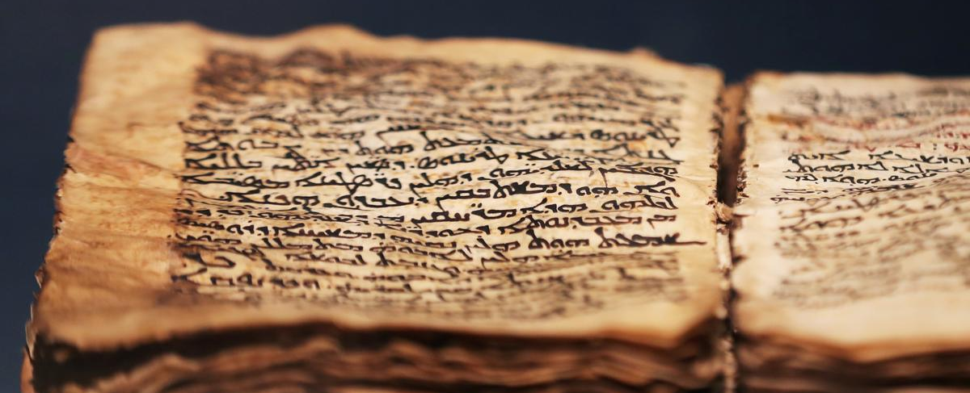
Case Study: Digitalization and Analysis of an Ancient Manuscript
Background: Acquisition of a significant ancient manuscript, rich in historical and cultural content.
Objective: To digitalize and analyze the manuscript, extracting new insights for academic and public use
This Photo by Unknown Author is licensed under CC BY-SA

Slide 44
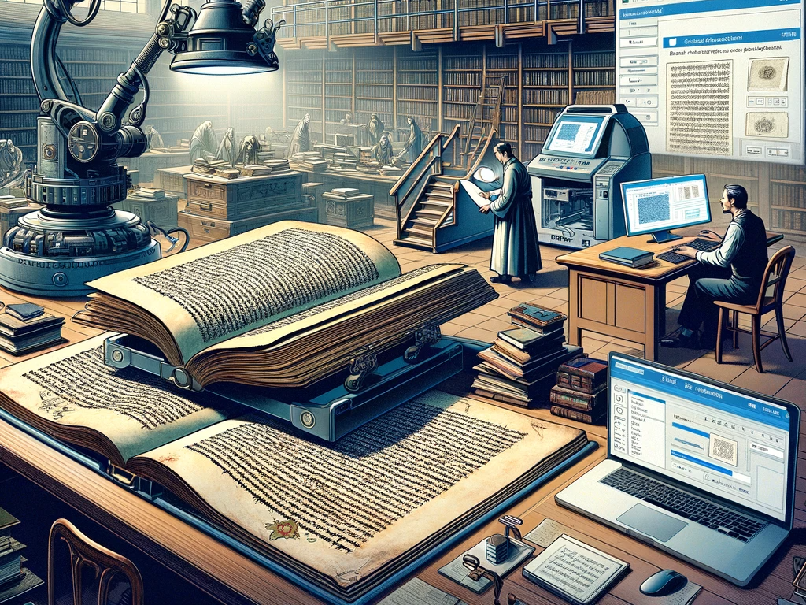
Case Study: Process
Acquisition and Digitalization: - High-resolution scanning and OCR for text conversion.
Data Cleaning and Preprocessing: Correcting OCR errors and normalizing text.
Data Analysis and NLP: Applying NLP for theme identification, sentiment analysis, and entity recognition.
Machine Learning: Using algorithms to uncover patterns and contextualize ambiguous texts.
Data Visualization: Visualizing findings for easy interpretation and developing interactive tools.
Insights and Applications: Gaining historical, linguistic, and cultural insights; identifying research opportunities.
Preservation and Access: Archiving digitally and creating an online public interface.
Ethical Considerations: Respecting the manuscript’s integrity and addressing privacy issues.

Slide 45

Case Study: Outcome
Transformation of the manuscript into a valuable digital resource, enhancing access and research.
Future Directions: Expanding the methodology to other historical documents for a global digital library.
This Photo by Unknown Author is licensed under CC BY-SA

Slide 46

Want to get started but can't wait until September?
There are many free or inexpensive online courses that can give you a headstart.
Mini Data Science course by Google
Books
Hands-On Machine Learning with Scikit-Learn, Keras, and TensorFlow: Concepts, Tools, and Techniques to Build Intelligent Systems 3rd Edition

Slide 47

Questions?
Code Repository for this seminar: https://github.com/ValRCS/rbs_greenhouse
THANK YOU!

